Slide 1

Sprocket Central Pty Ltd
Data analytics approach
Sanika Ardekar

Slide 2
Agenda
Approach is implemented in these 3 steps:
Data Exploration
Model Development
Interpretation

Slide 3
Introduction
Approach for New Customer Data Analysis
Age Distribution
Bike related purchase in past 3 years
Job industry
Number of cars owned

Slide 4
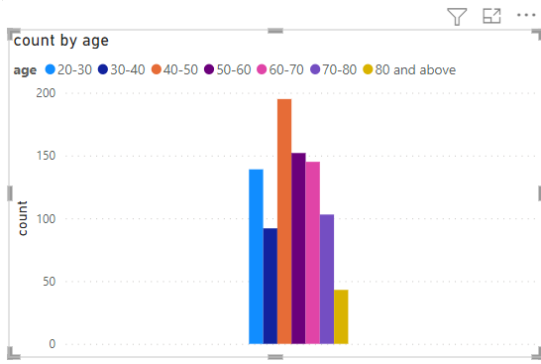
Data Exploration
Age Distribution.
Here we can see that new customers have a higher frequency for 40-50 years and 50-60 years.
The above age range include adults who have stable incomes and their families might include children as well as senior citizens.
Fewer customers are from 30-40 years, and 80 and above age range.

Slide 5
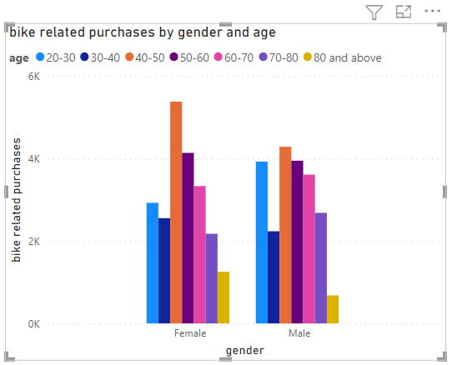
Data Exploration
Bike related purchase in the last 3 years.
Here we can see that Females have more purchases than males.
Females and males in the age range 40-50 years have have the highest purchase count hence we can target our marketing and sales strategy towards the age group 40-50 years and 50-60 years.

Slide 6
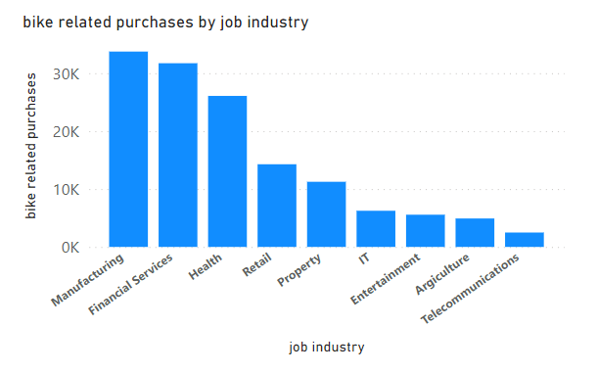
Data Exploration
Job Industry
Here we have compared bike related purchases with the job industry.
Manufacturing and Financial Services as well as Health sector customers score high with the frequency of bike related purchases.
Hence we can target customers in the age range 40-50 and 50-60 who work in the above mentioned industries to boost our sales.

Slide 7
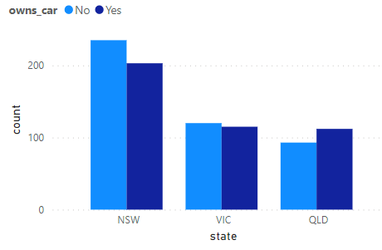
Data Exploration
Number of Car owned.
Here we have compared car owned status (yes or no) with the states.
New South Wales can prove to be a potential area for our marketing and sales since the number of customers who own a car are nearly equal to the number of customers who do not own a car.
This indicates that there is room for value customers.

Slide 8
Model Development
We have identified key attributes which need to fitted in a model and further processed.
These key attributes include: age, job industry, purchases related to bikes, car owns status and the state of residence of the customer.
Age : 40-50 years and 50-60 years
Gender : Females more than males.
Job industry : Manufacturing and Financial Services as well as Health sector
State : New South Wales and Victoria.

Slide 9
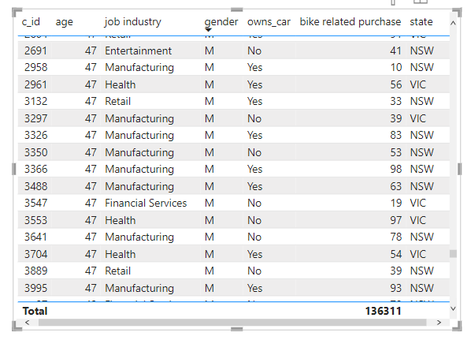
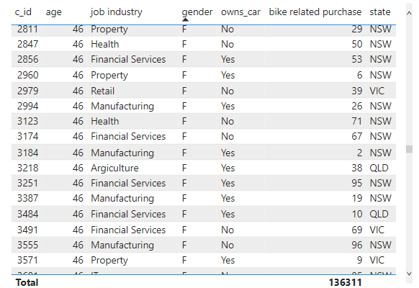
Interpretation
Summary :
Males Females

Slide 10
Note: The data and information in this document is reflective of a hypothetical situation and client. This document is to be used for KPMG Virtual Internship purposes only.
Thank you

